Slide 1

.

Slide 2

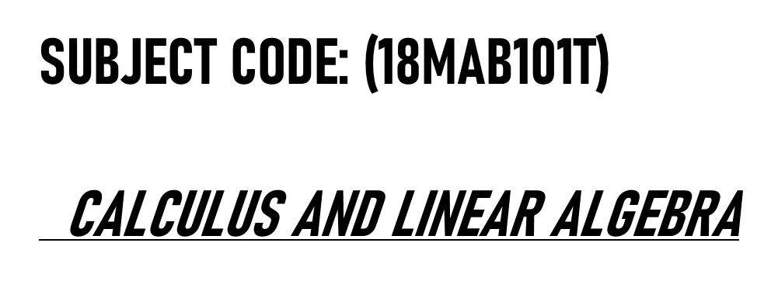
(18MAB102T)
ADVANCED CALCULUS AND COMPLEX ANALYSIS

Slide 3
Application Of complex analysis

Slide 4
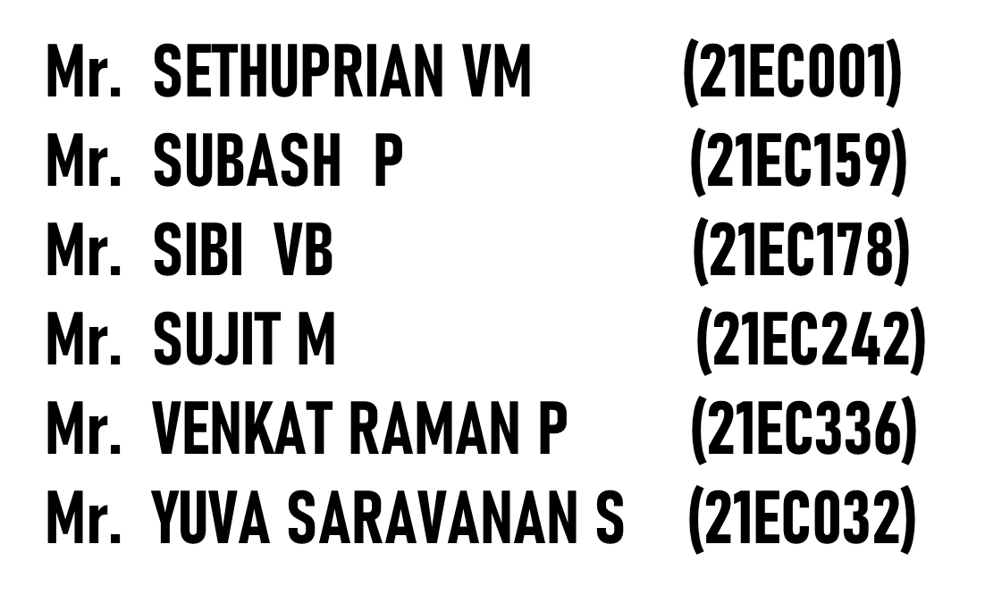

TEAM MEMBERS
(21BEC193)
(21BEC213)
SUBASH S
(21BEC214)
(21BEC221)
(21BEC236)
(21BEC248)

Slide 5


